Slide 1
Micflix
A netflix clone - by Mickey Krekels
Class: RB04

Slide 2
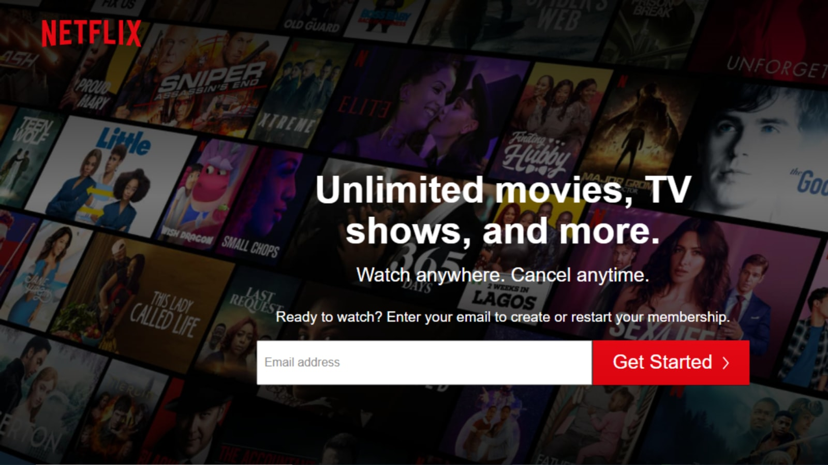

non-functional requirements
Usability
Security
Scalability
Maintainability.
Notes:
Usability is a non-functional requirement, because in its essence it doesn't specify parts of the system functionality, only how that functionality is to be perceived by the user, for instance how easy it must be to learn and how efficient it must be for carrying out user tasks.
The non-functional security requirements specify a security quality or attribute that the software must possess. ... The software must remain resilient in the face of attacks. The behavior of the software must be correct and predictable. The software must be available and behave reliably even under DOS attacks.
Scalability is a non-functional property of a system that describes the ability to appropriately handle increasing (and decreasing) workloads. According to Coulouris et al. ... Scalability competes with and complements other non-functional requirements such as availability, reliability and performance.
Maintainability is how easy it is for a system to be supported, changed, enhanced, and restructured over time. ... This impact makes maintainability an important non-functional requirement to consider when developing software.

Slide 3
Enterprise Grade Software
Technologies / Techniques:
Microservices
Docker
Kubernetes
GitHub Actions
MongoDB
RabbitMQ
Languages:
Golang (C# if Golang proves to be not ideal)
ReactJS

Slide 4
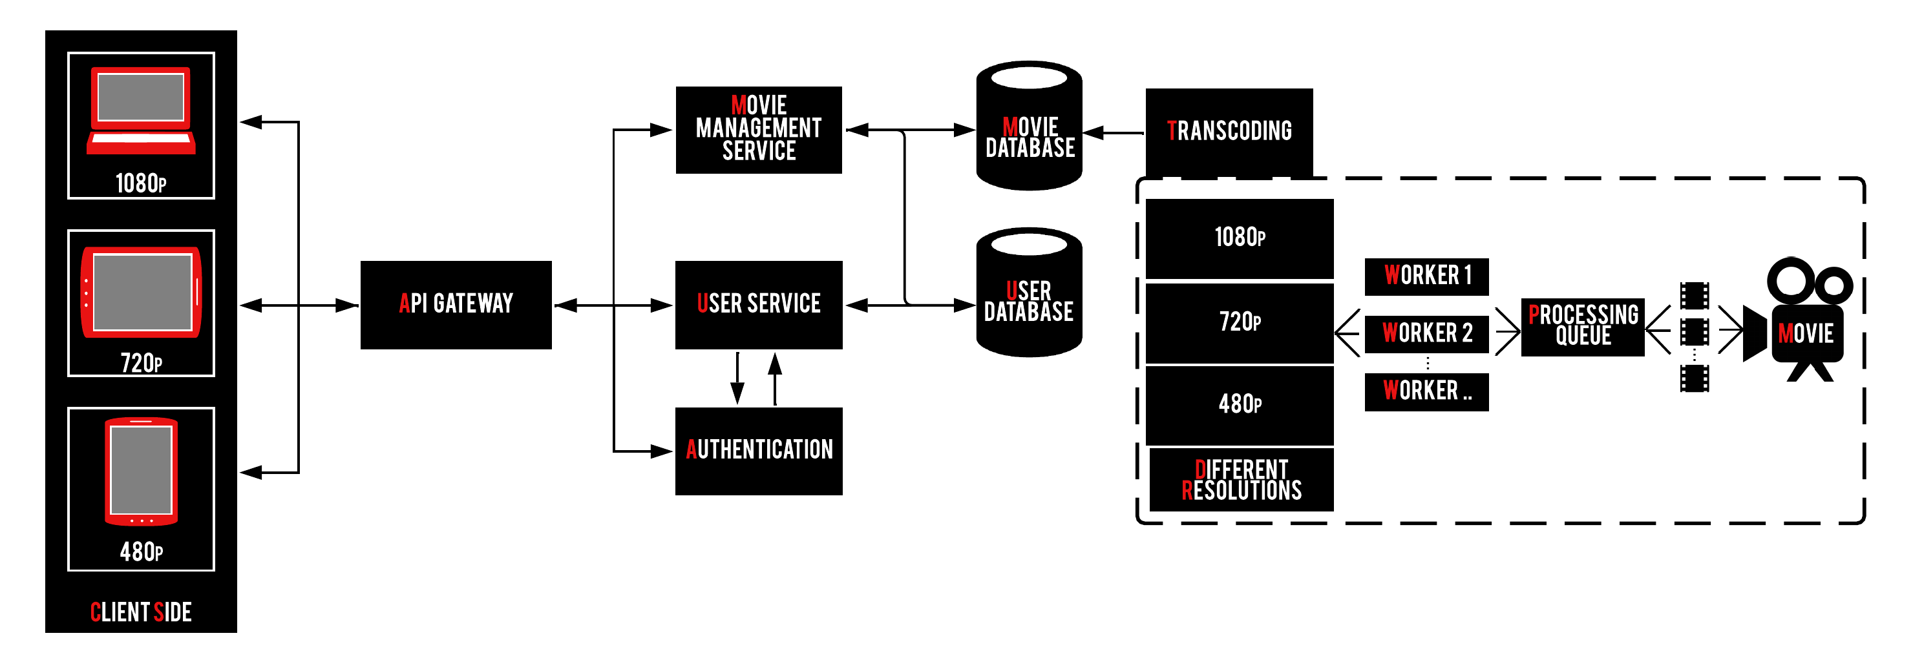
Project architecture

